Slide 1
MS Azure – Day 1

Slide 2
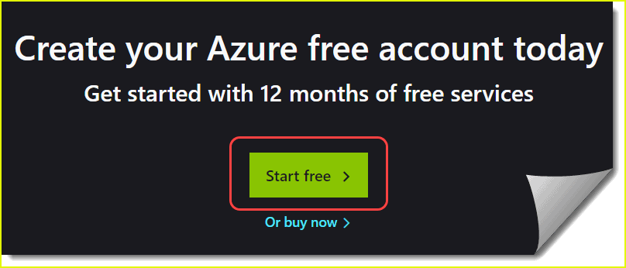
Hands-On to Create Azure Account
Step1 - In a web browser, go to https://azure.microsoft.com/free
Step2 - Learn more about the benefits and free services available
Step3 - Click on the Start free button

Slide 3
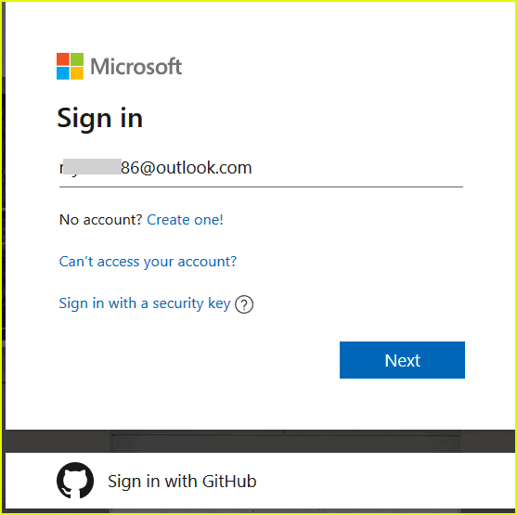
Step4
Enter your email id and password

Slide 4
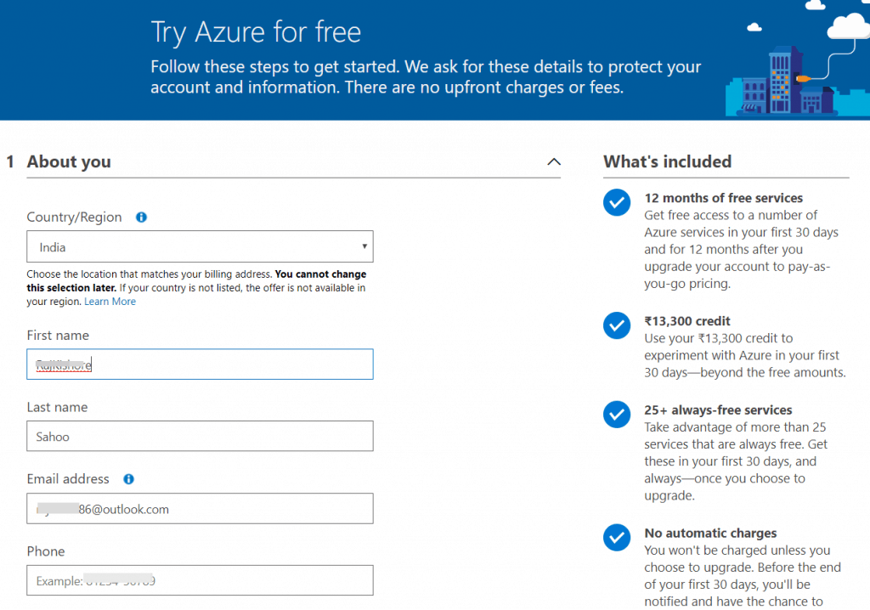
Step5 - Enter personal details like Country/Region, First name, last name, Email Address, Phone, City, etc.
Fill in all the details and click on Next.

Slide 5
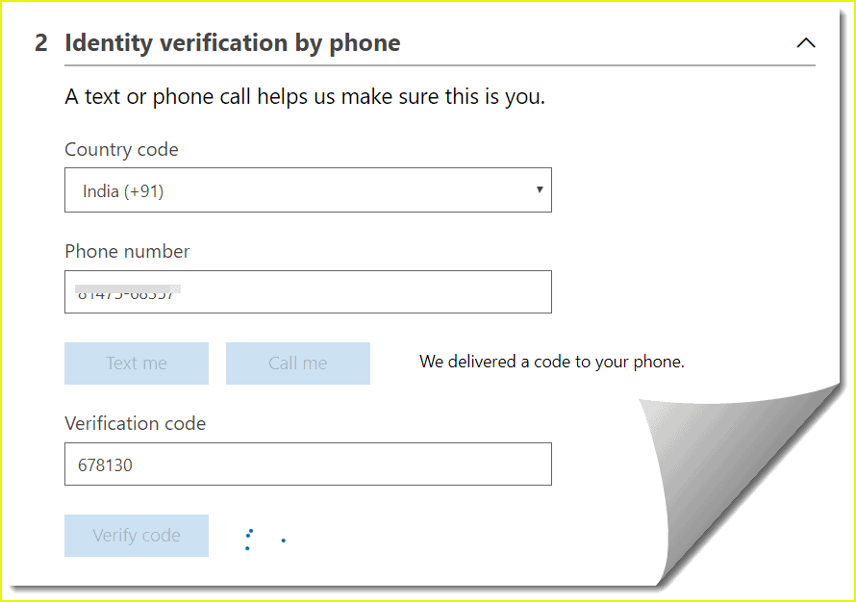
Step6 - Identity verification by phone
Provide the Phone number details, make sure to provide a valid phone number. Because you need to confirm by a text message or by a call.
Once verification is done, click on Next

Slide 6
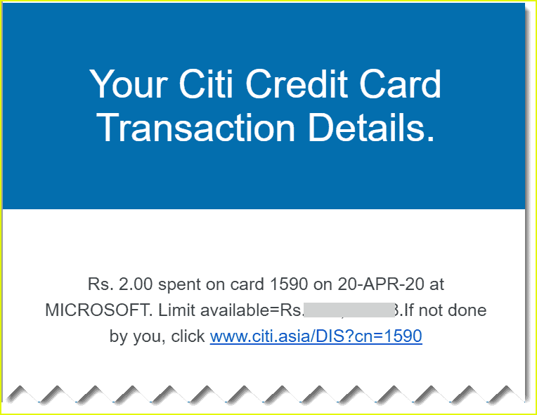
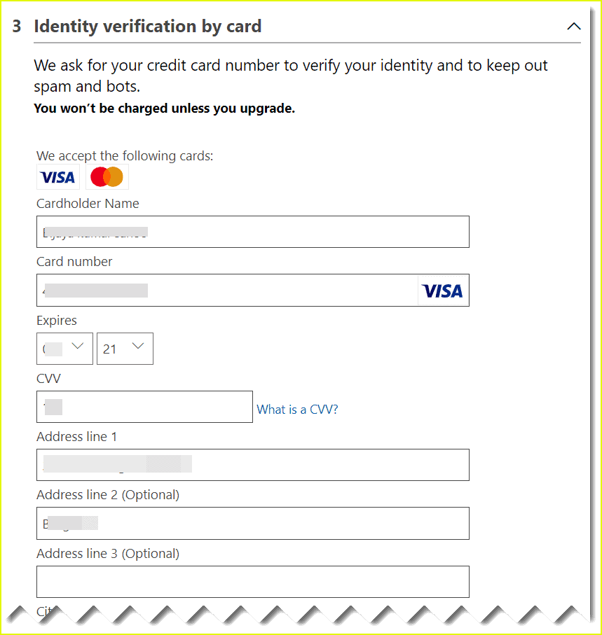
Step7 – Identity verification by card
Provide the credit card details. Azure deduct a refundable amount of money(2 or 3rs) from your account.

Slide 7
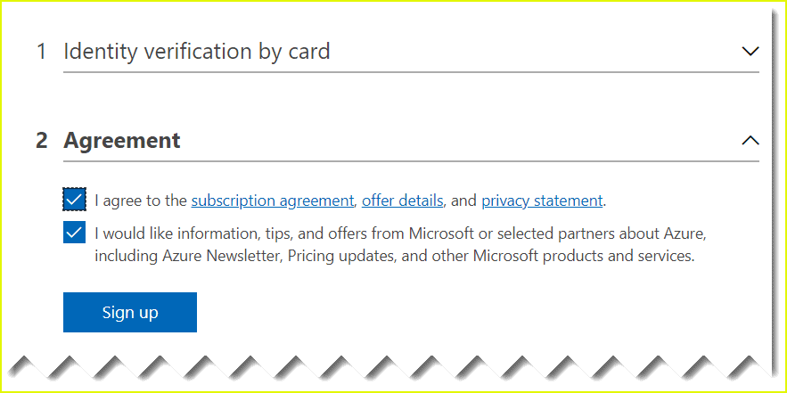
Step8
Review the agreement and privacy statement then select Sign up.

Slide 8
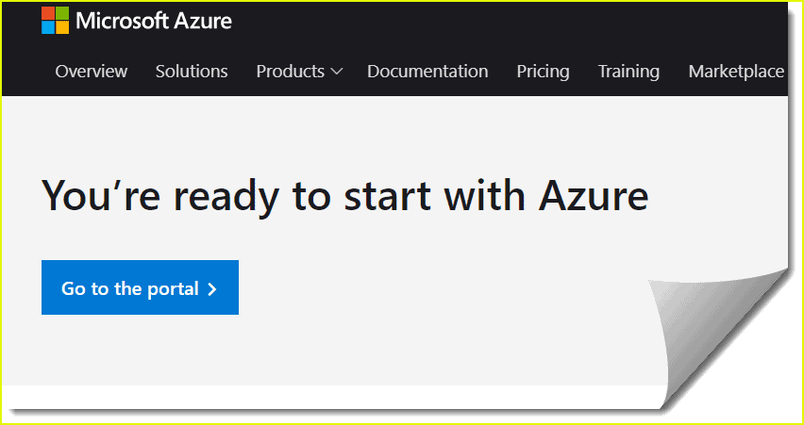
Step 9
Select Go to the Azure portal, now you can access the Azure portal.
Congratulations! You have successfully set up a free account.

Slide 9
THANK YOU

